Slide 1
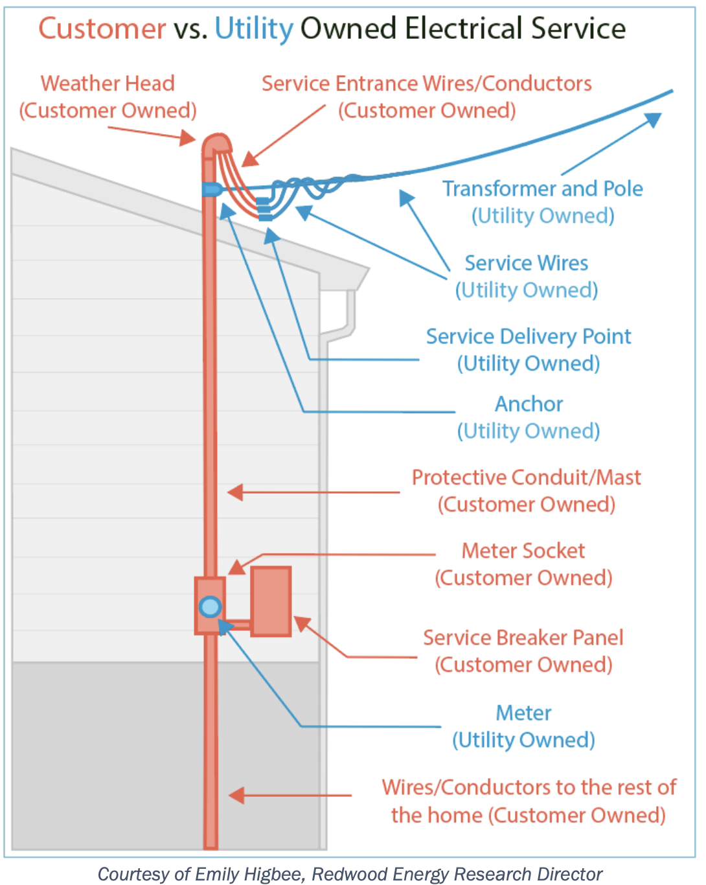


Slide 2

Notes:
Photo of house front. This footnote describes house: square footage, #bedrooms/baths. Built in 1950s; inside renovated in 2021 with all gas appliances

Slide 3
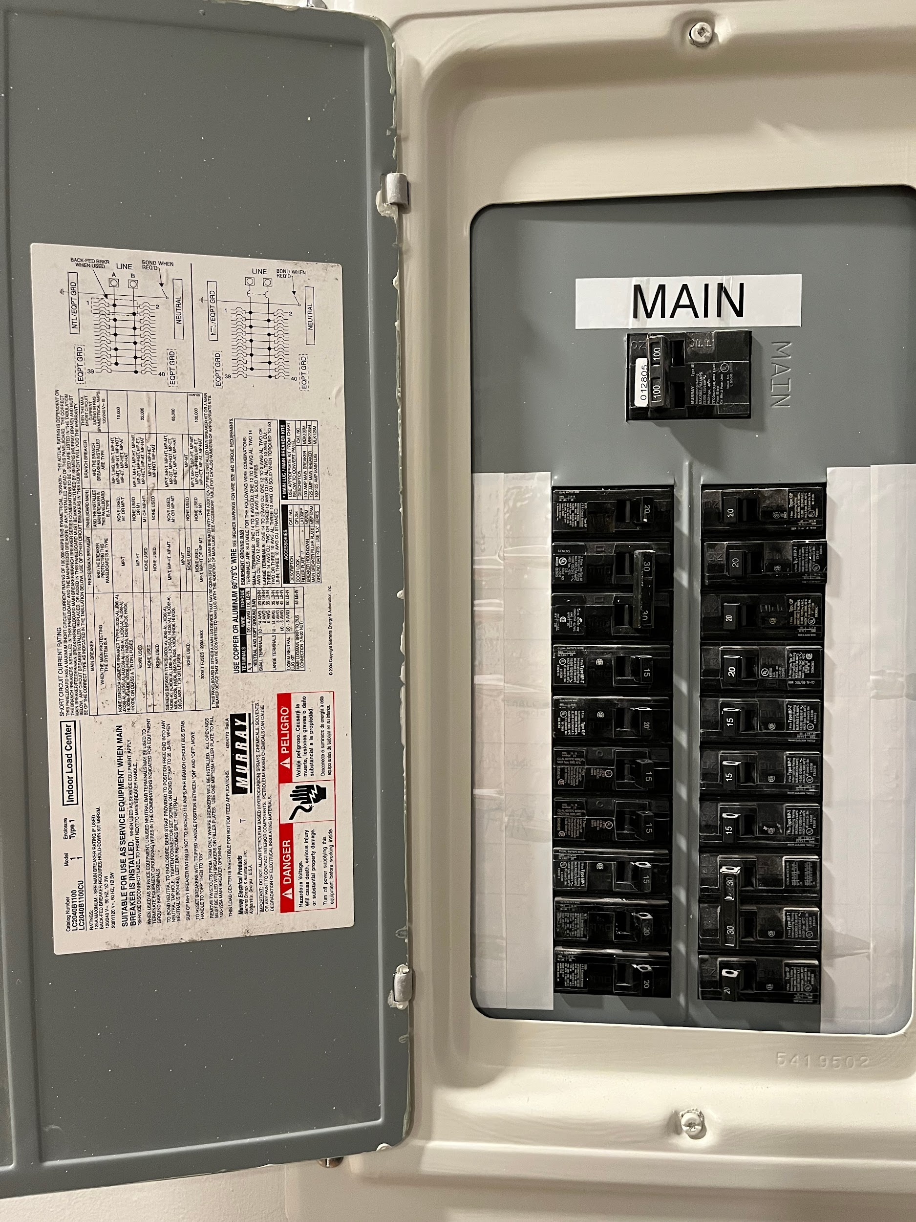
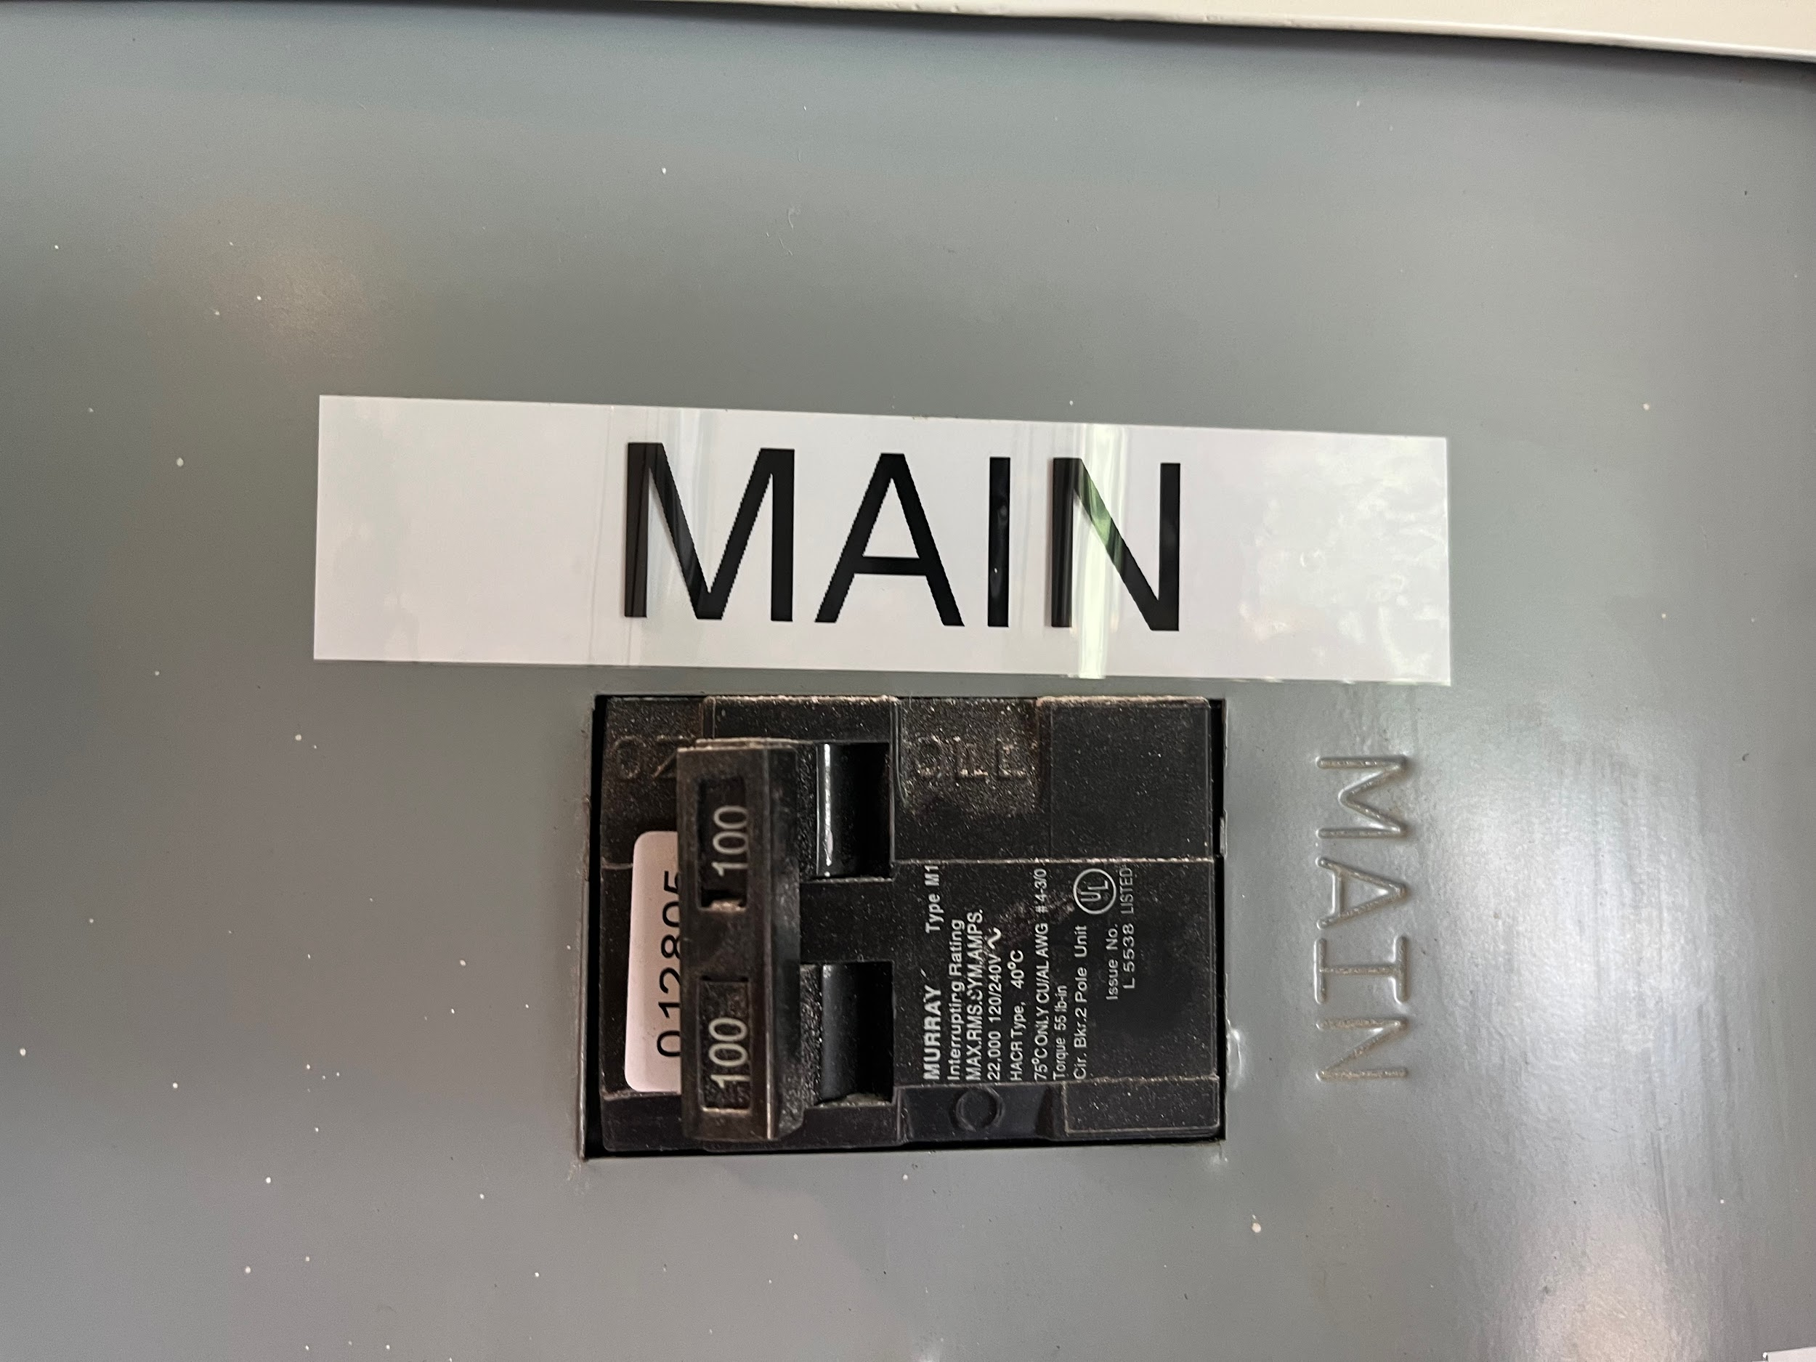
Notes:
Closeup photo of all breakers in electrical panel (focused, should be able to read the numbers on each breaker )

Slide 4
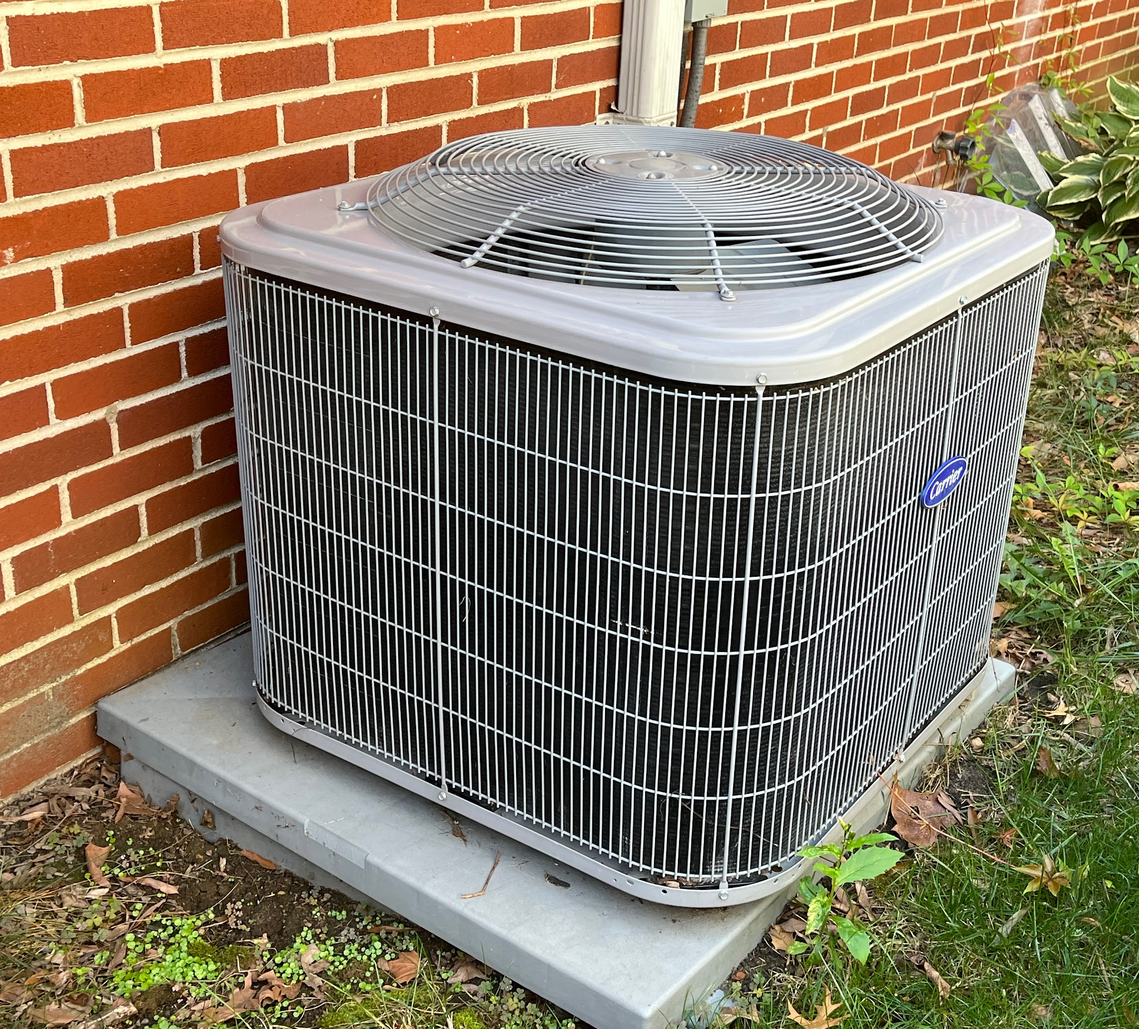
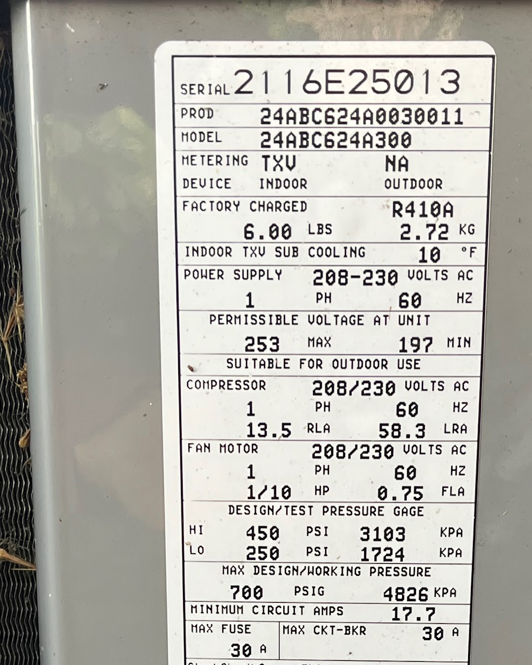

Slide 5
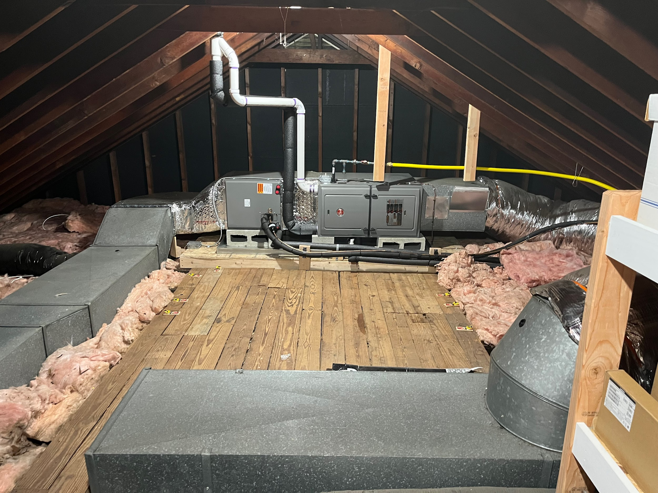
Remove Black and White exhaust tubes, Yellow gas line and Boards supporting gas line. ,
Air Seal and Insulate Attic, Maximum Insulation Under Attic Floorboad
Seal and Insulate Ducts,
Consider moving Air handler closer to shorten return air duct for better air flow and less loss

Slide 6
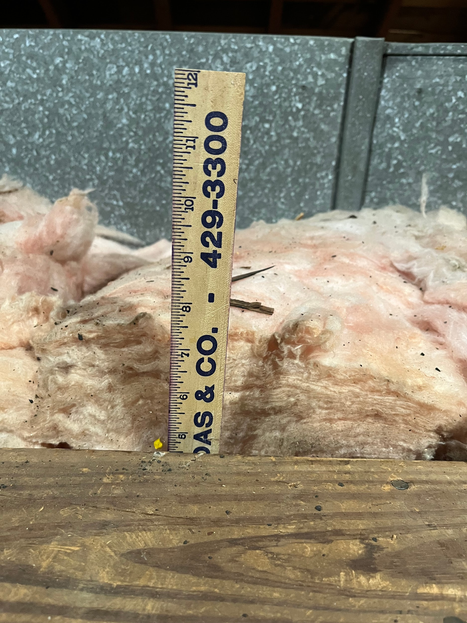
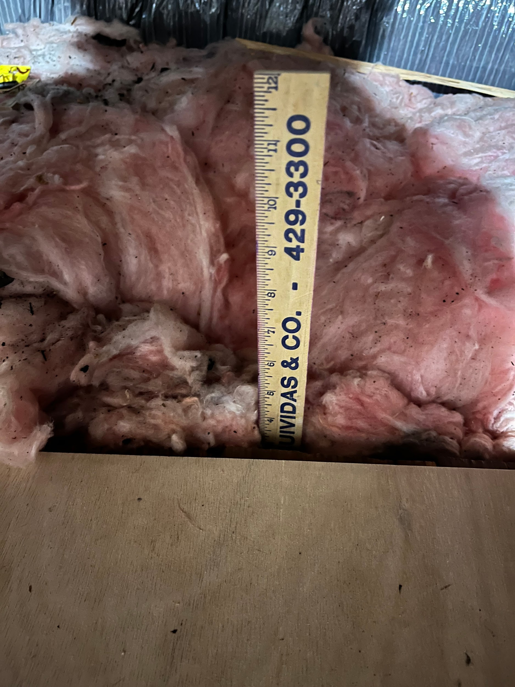

Slide 7
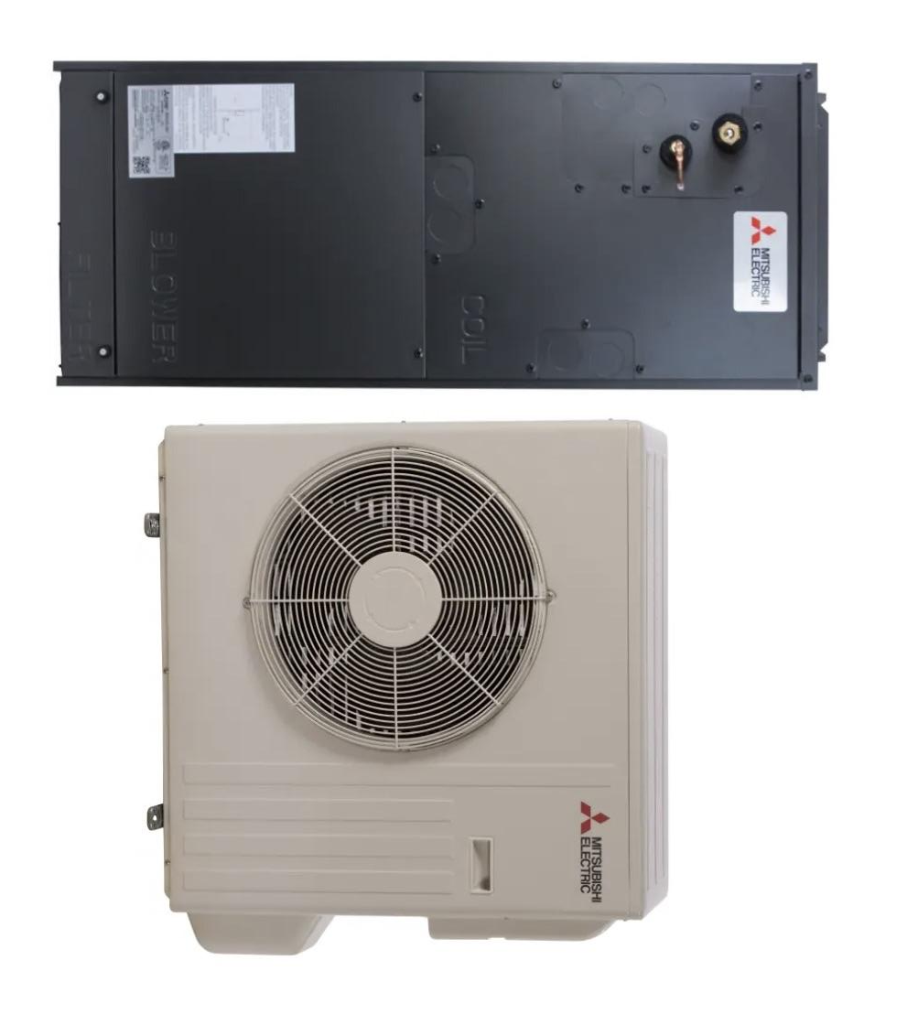
Replace
Horizontal Furnace
with
Horizontal
Heat Pump Air Handler
3 Ton Air Handler in attic
3 Ton inverter driven compressor outdoors on stand
Increase attic and wall insulation and Air Sealing plus Duct Sealing and duct insulation to cut heat loss by 30% or more to allow for 3 ton heat pump on existing repaired duct work.

Slide 8
The Range of Efficiency in HVAC Heat Pumps

Slide 9
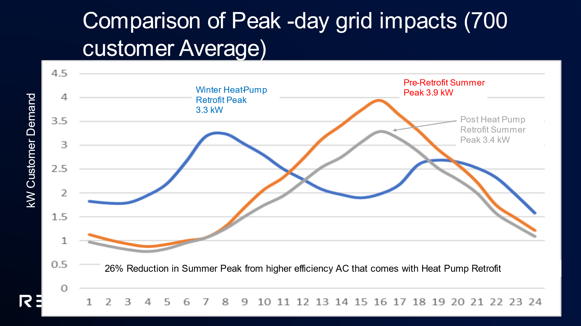
SMUD Data on Their Heat Pump Retrofits-26% Reduction!

Slide 10


120V Mist Fireplace Replacements

Slide 11
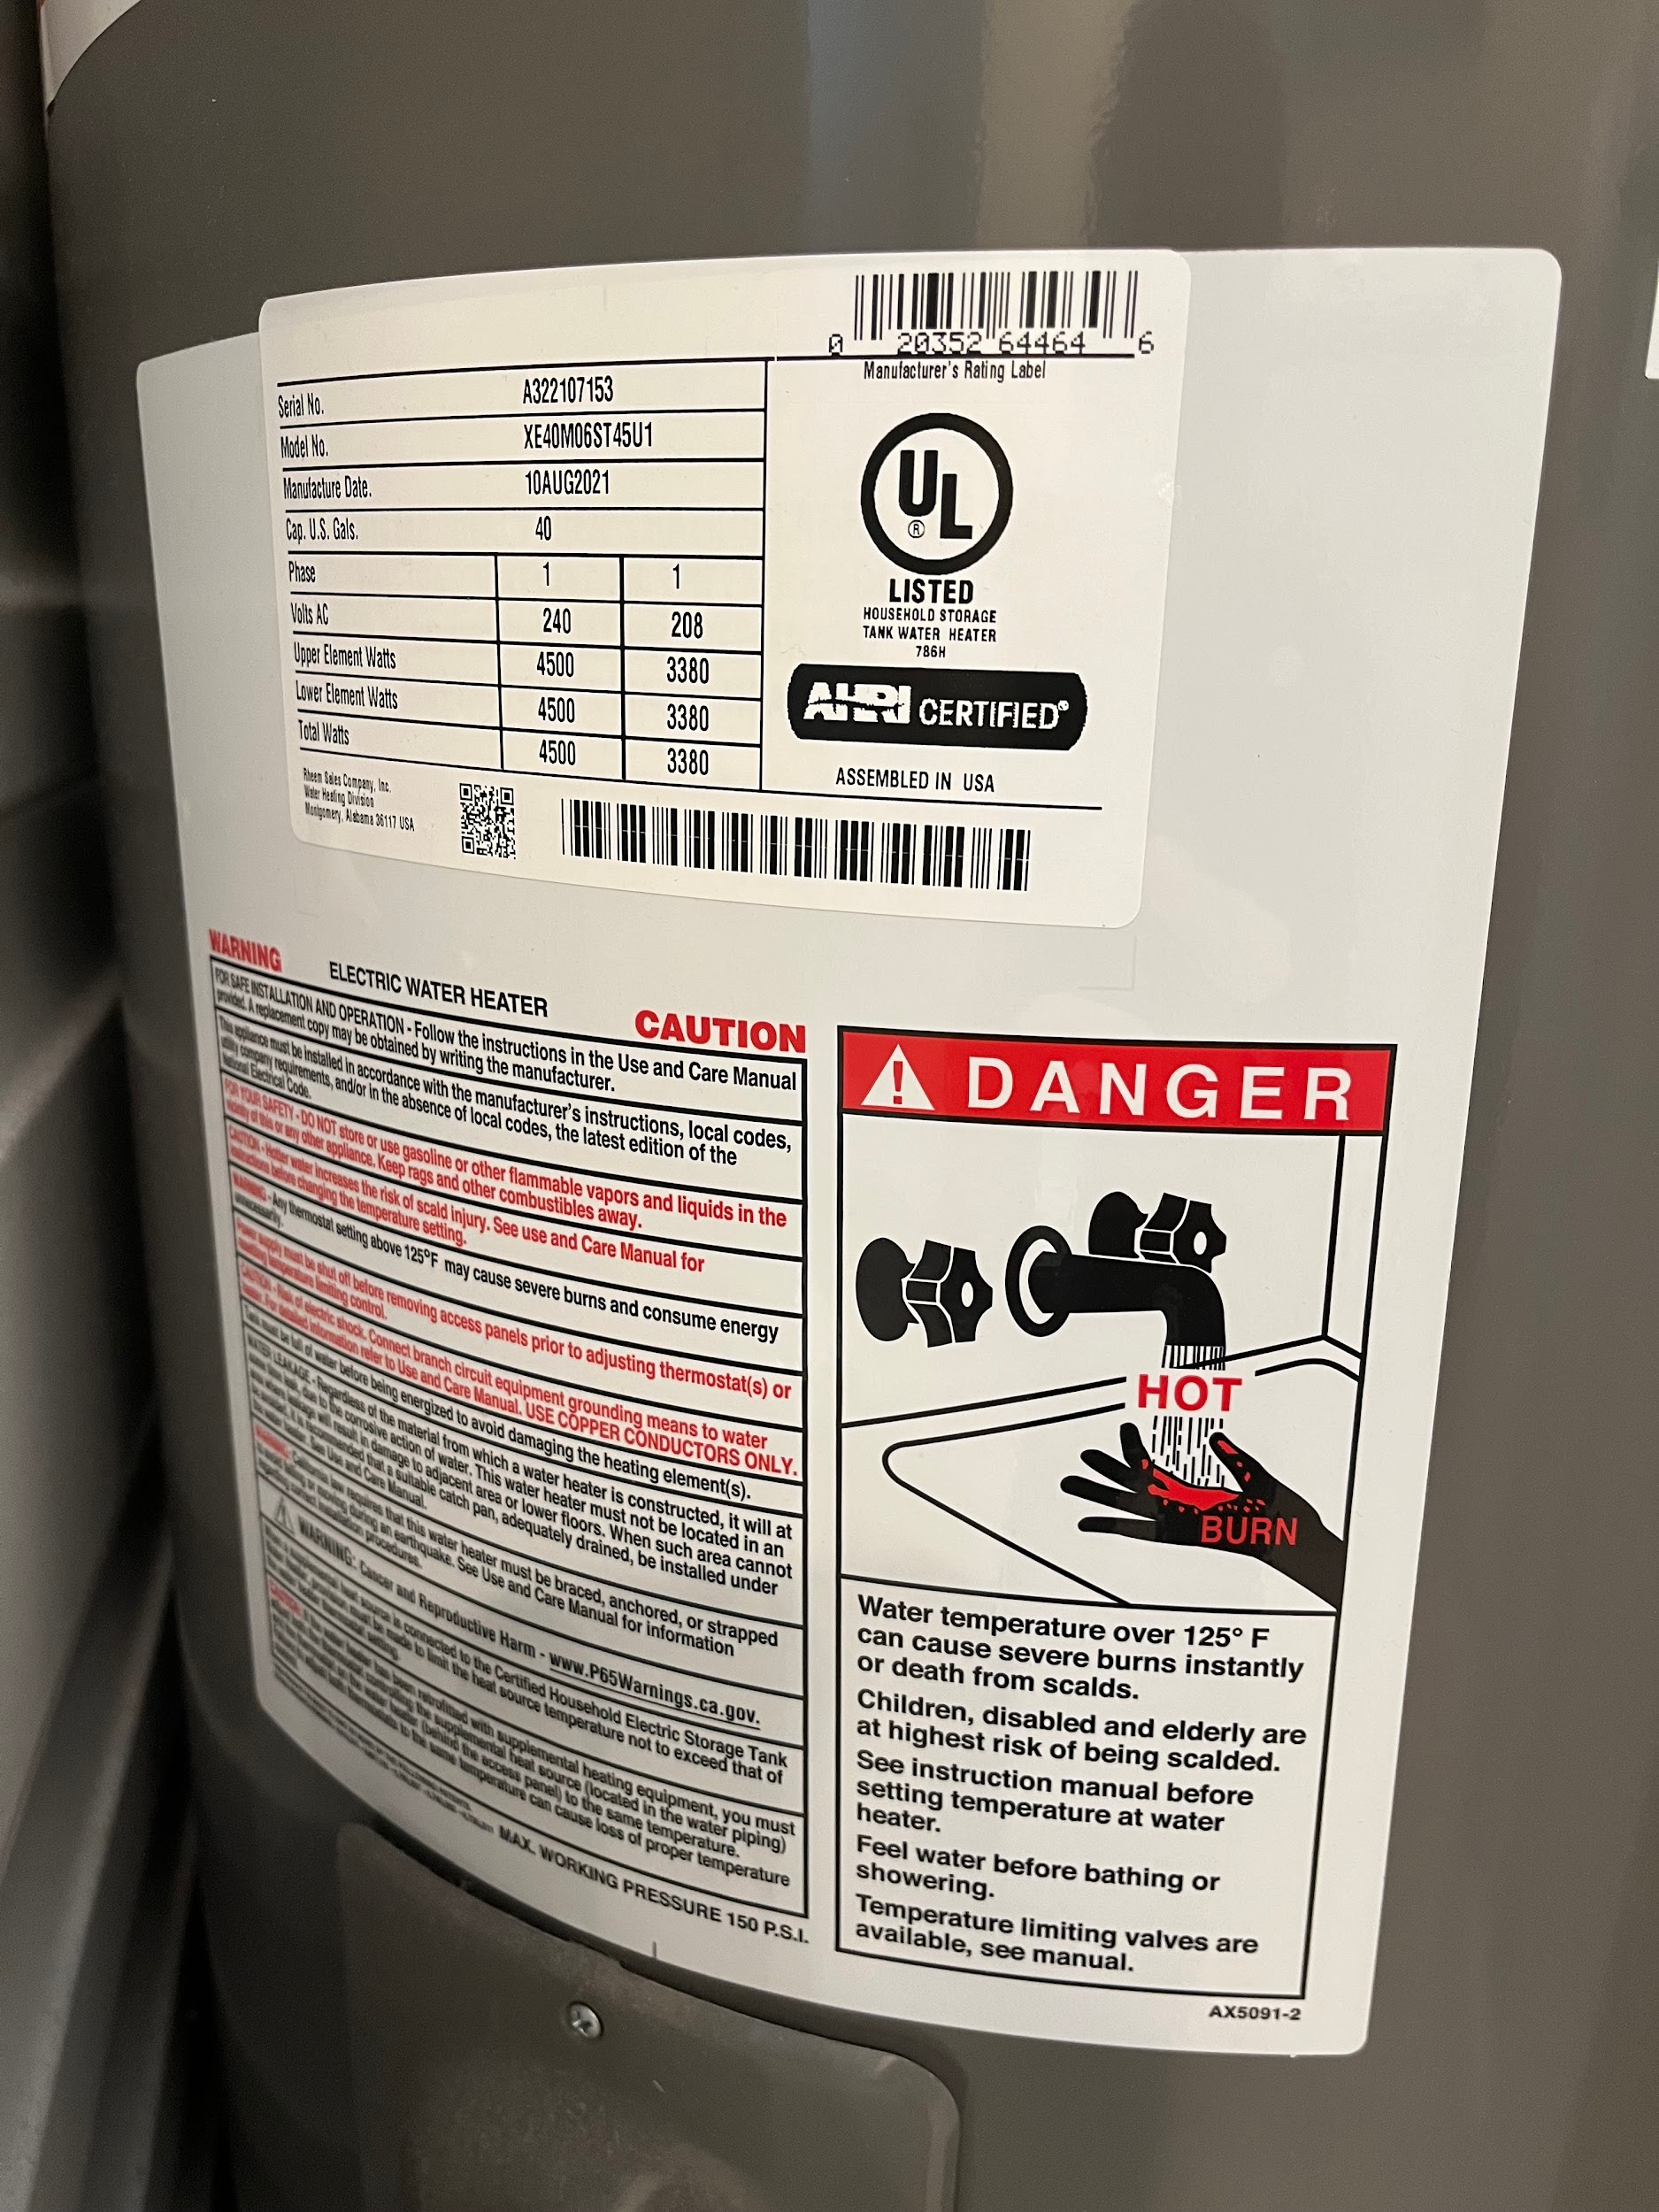
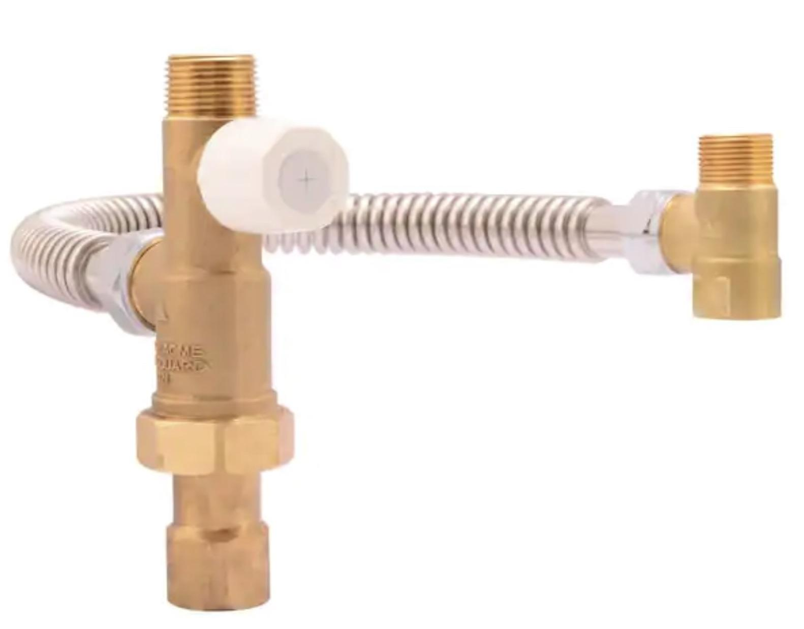
Existing 40 Gallon 240V 4500 Watt WH
Possible Way for save 0.8 kW on the electric panel and a pole space.
Existing 40 Gallon 240V 4500 Watt WH
Perhaps could be rewired to become a 120V 1600 Watt HW with a $100 Thermostatic mixing valve that lets it store more heat for more hot water
30A, 40 gallon electric resistance tank.

Slide 12
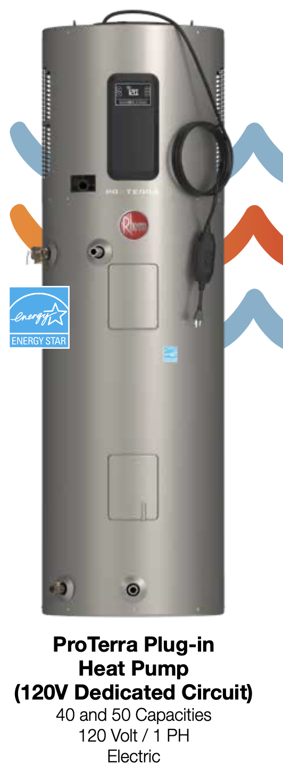
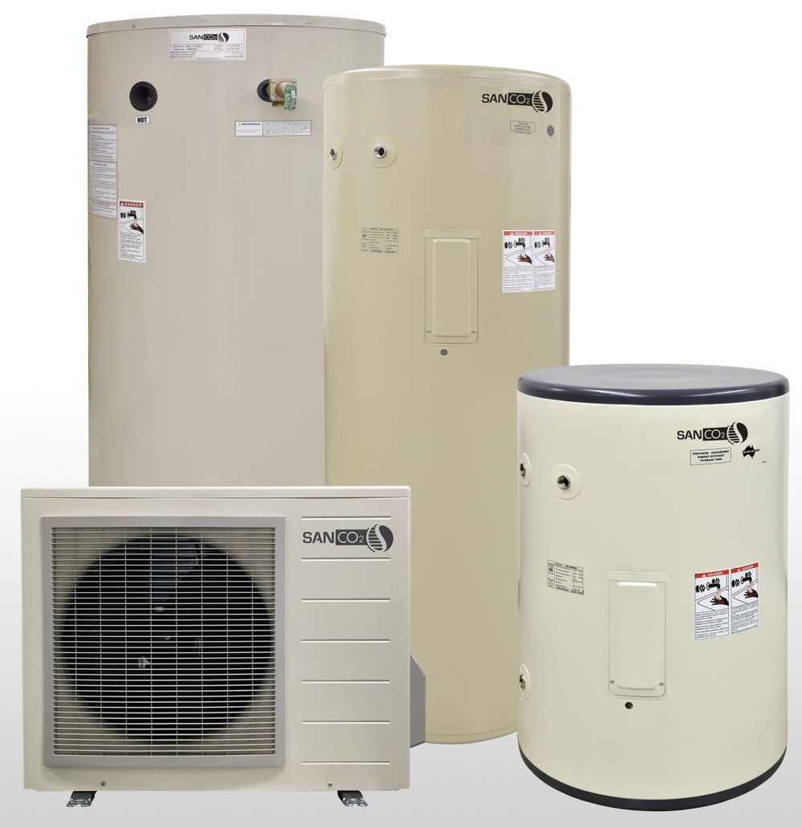
900W Heat Pump Water Heaters: Rheem & AO Smith (120V) and SanCO2 (240V)

Slide 13
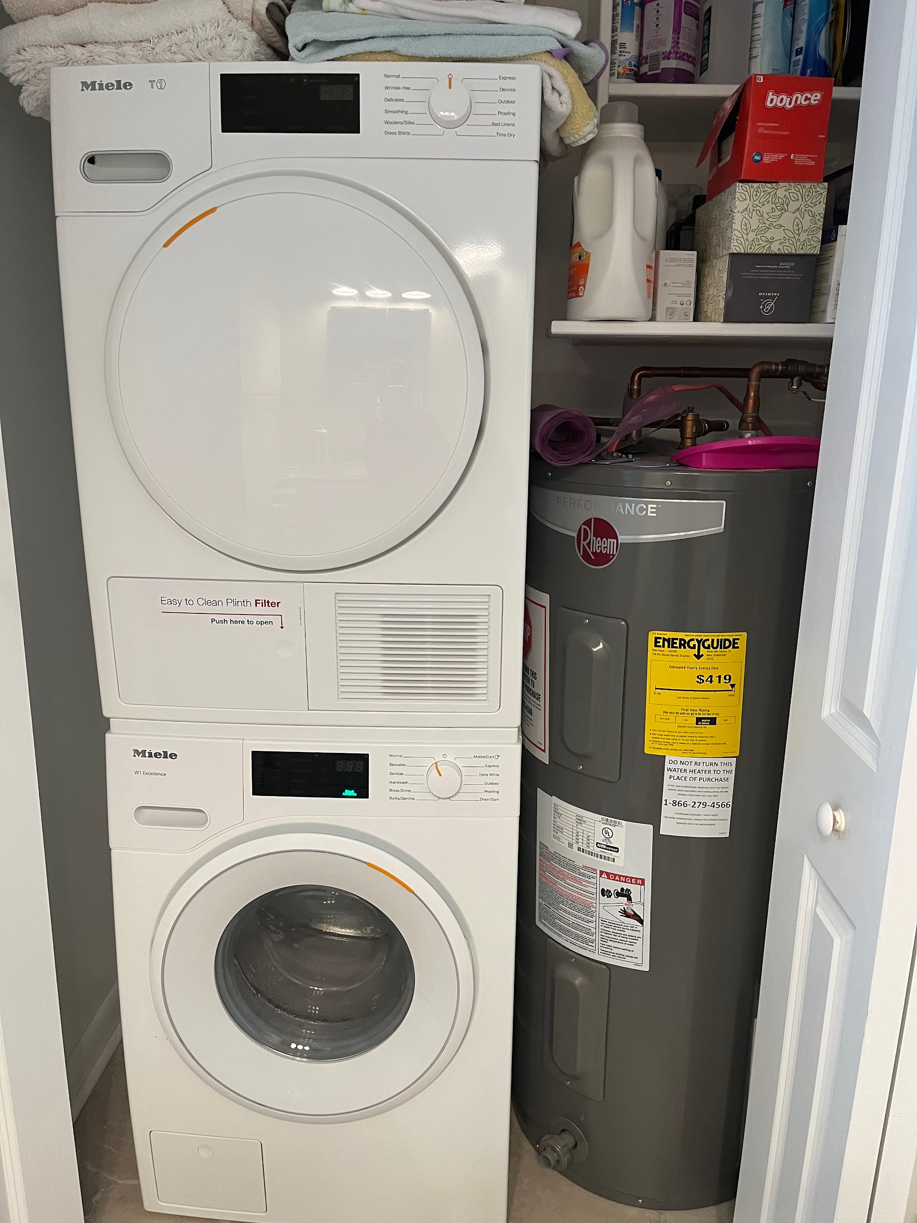
Hot water heater and washer/dryer are in the bathroom closet, middle of the house.
Washer/dryer are electric and do not require ventilation.
Notes:
Photo of the furnace and/or hot water - showing physically where located in the house

Slide 14
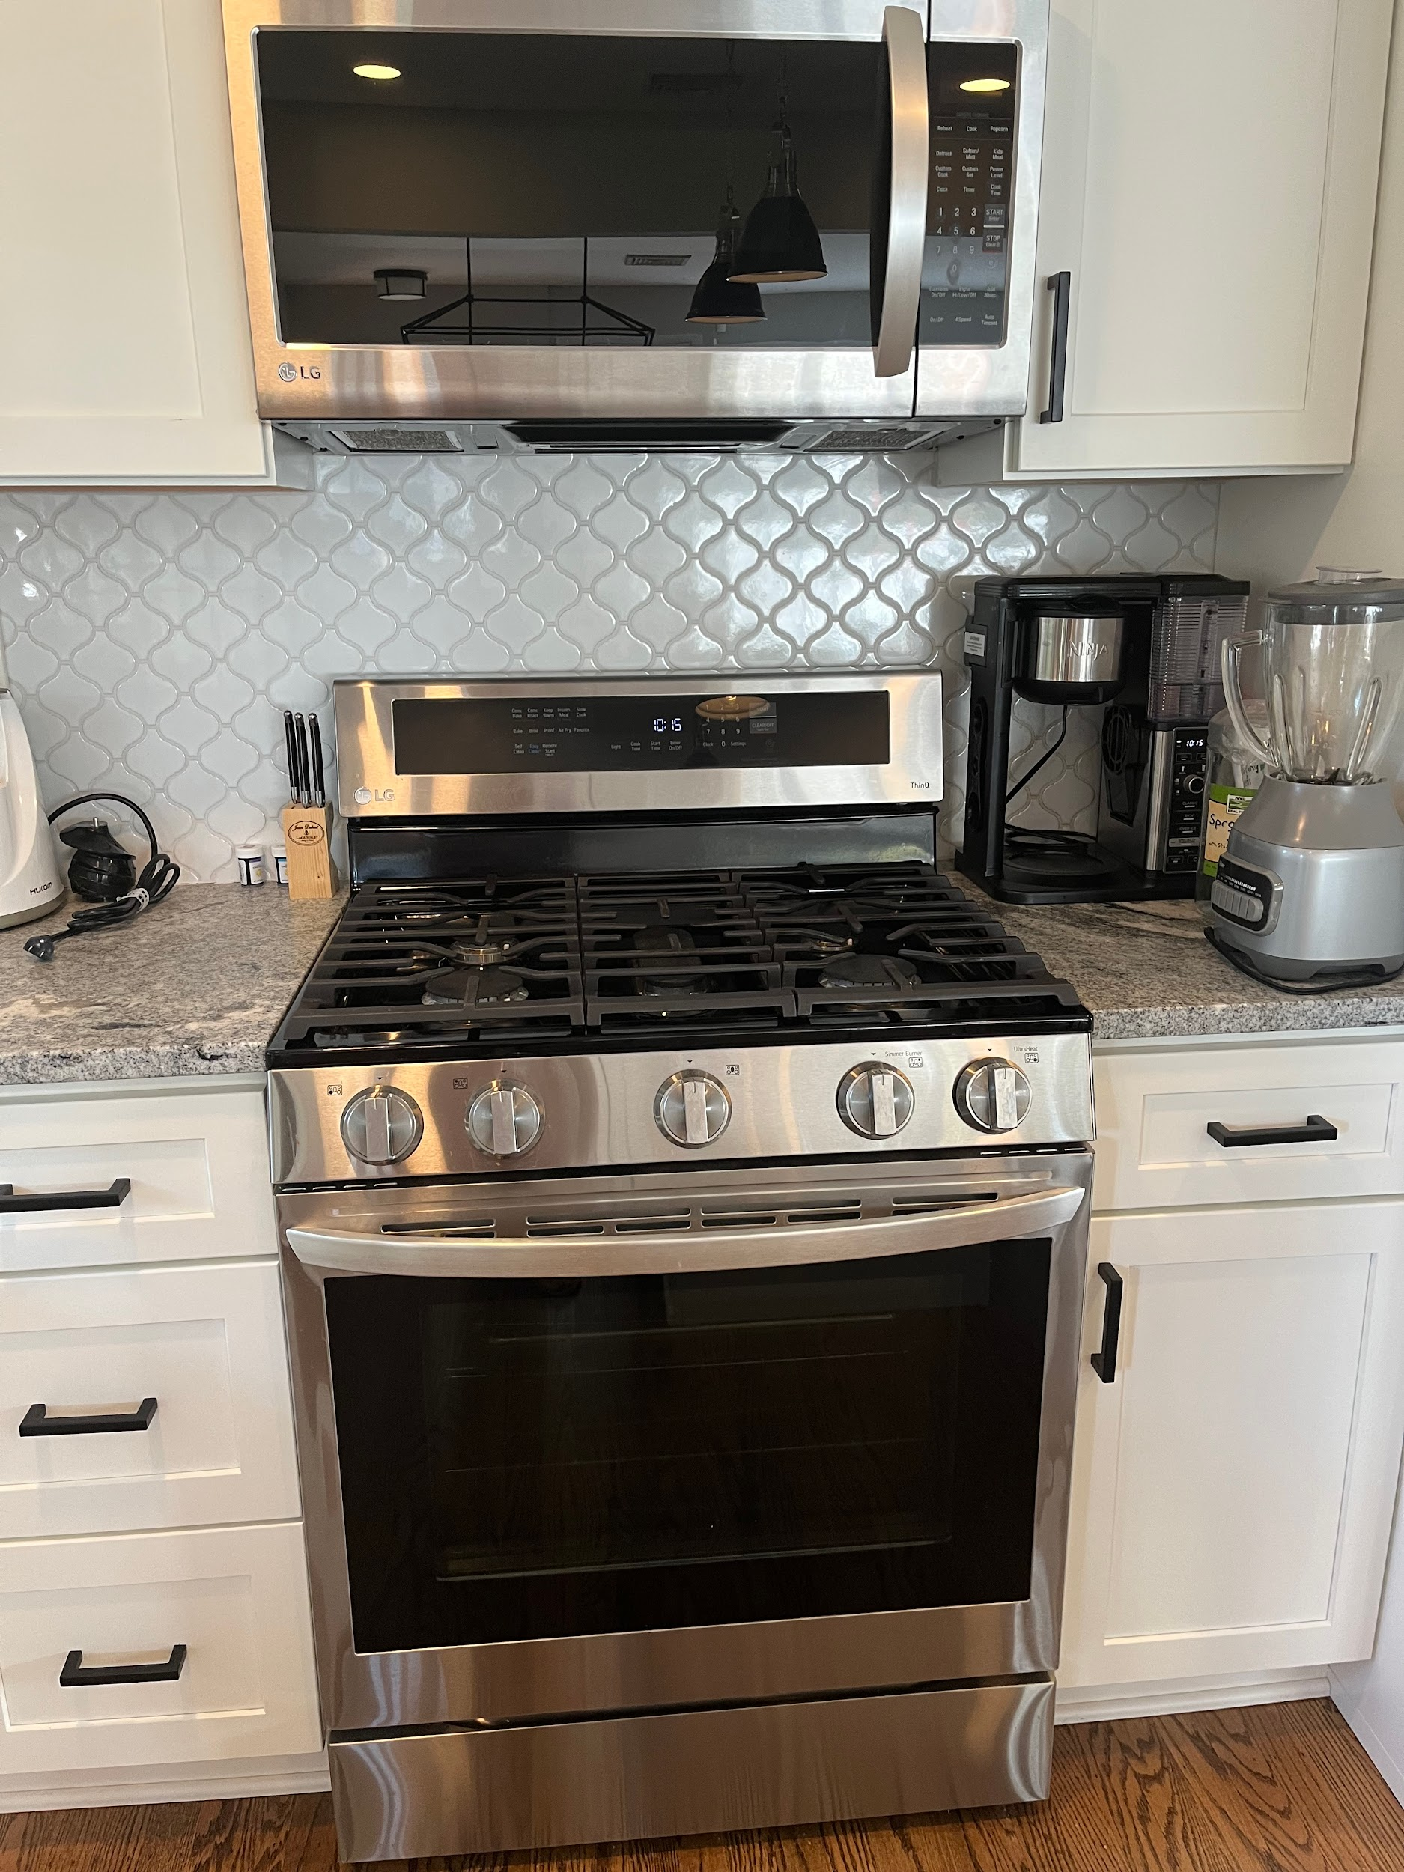


30” Gas Stove Replaced with $1k to $6.3k Induction Range + $500 Wiring

Slide 15
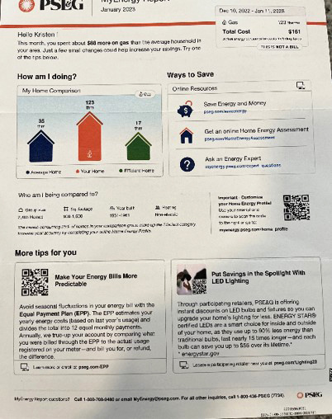
Thought this might be of interest.
Report from PSE&G detailing my home’s gas usage compared to similar nearby properties.
Notes:
Any additional labels

Slide 16
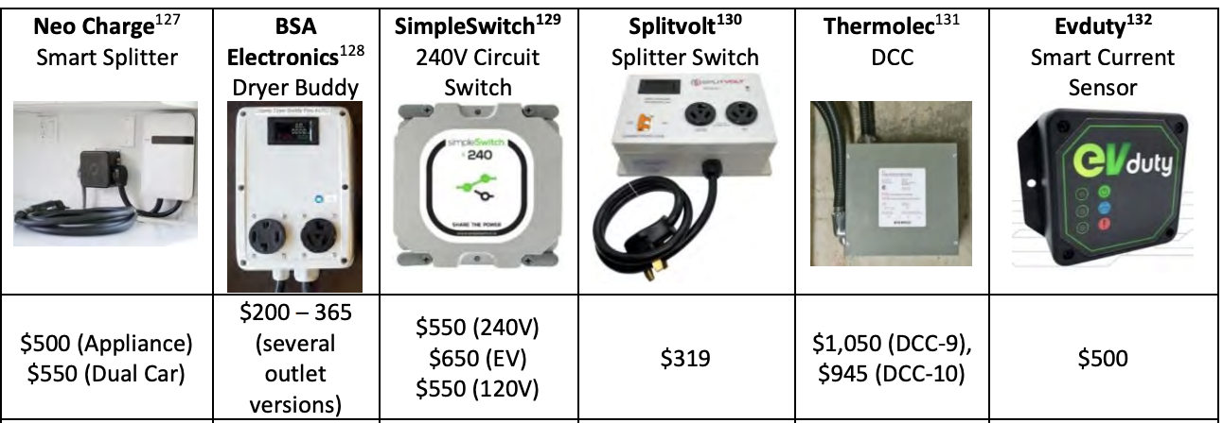
Smart Circuit Splitters for Sharing a 240V Outlet

Slide 17
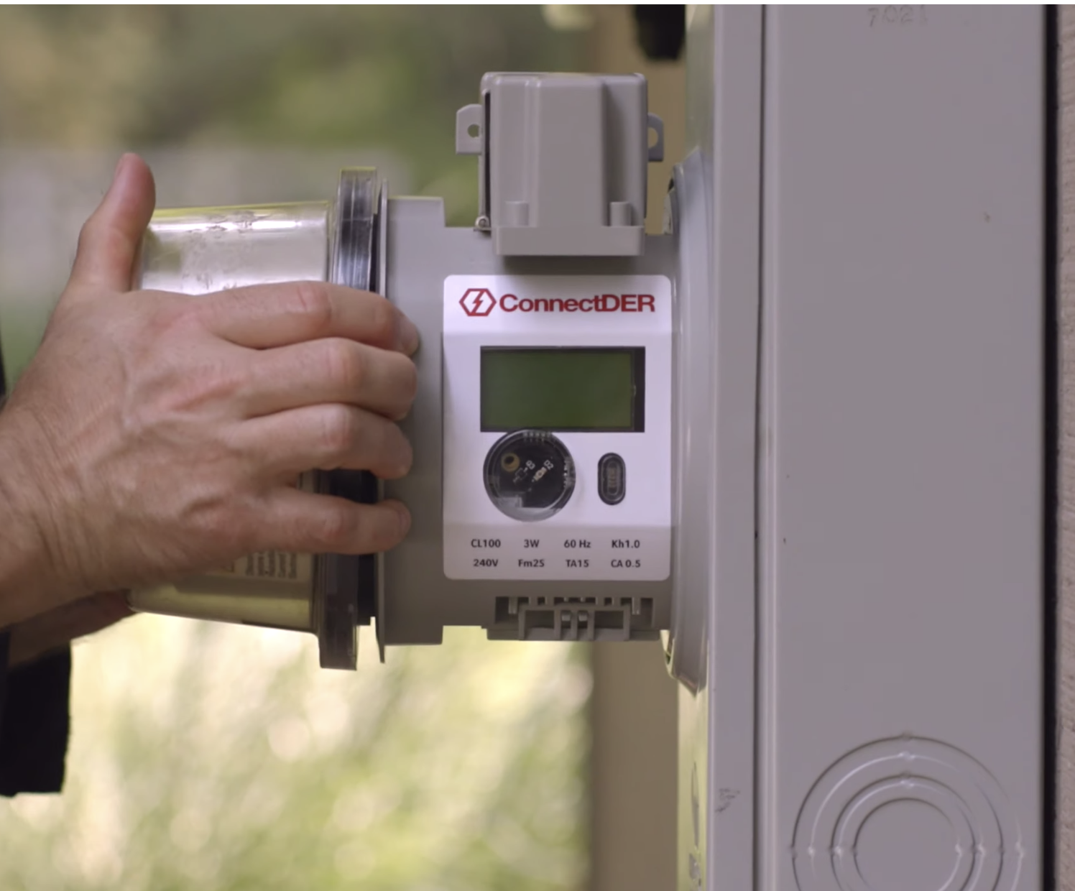

10/15/2023 the utility meter collar used in California is not yet available/ approved in NJ. It's a Philadelphia company/Siemens collaboration. It is approved in PA and 16 other states. John W.
ConnectDER utility collar: Up to a 15kW solar array or EV charger on a 100A utility service
https://connectder.com/for-installers/

Slide 18
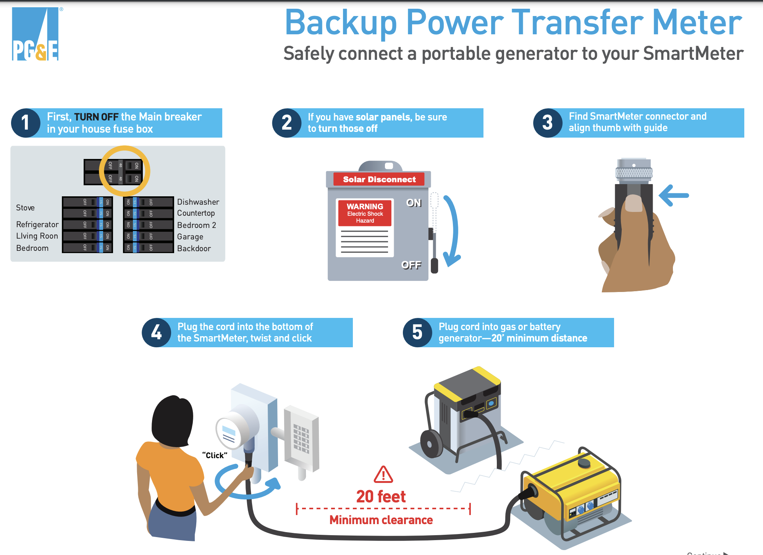
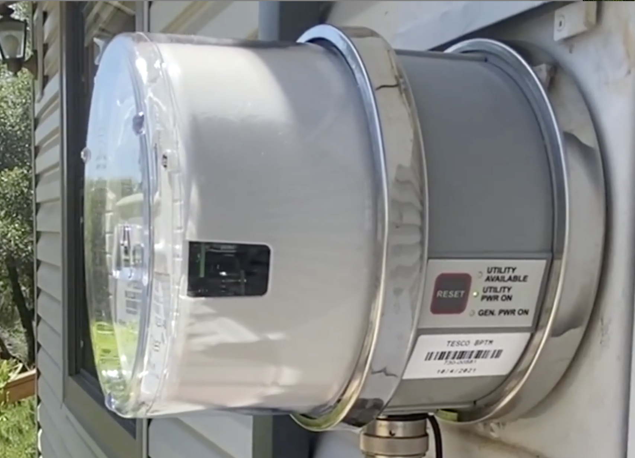

PG&E and Ford agreed in 2022 that the F-150 Lightning’s on-board 7.2kW inverter safely replaces a generator during outages.

Slide 19


Lumin SubPanel: 30A service can support 150A of loads.

Slide 20
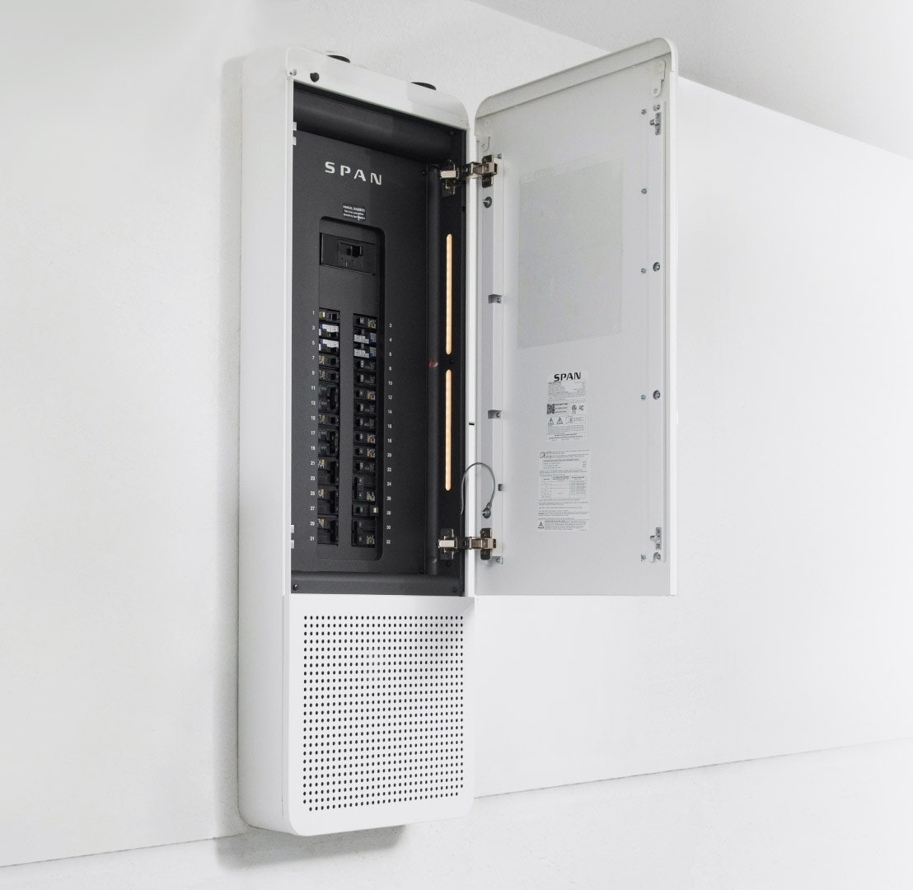
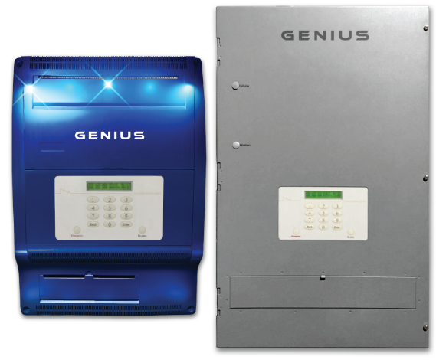
Whole House Management Panels:
100A Can Support 400A of Loads

Slide 21

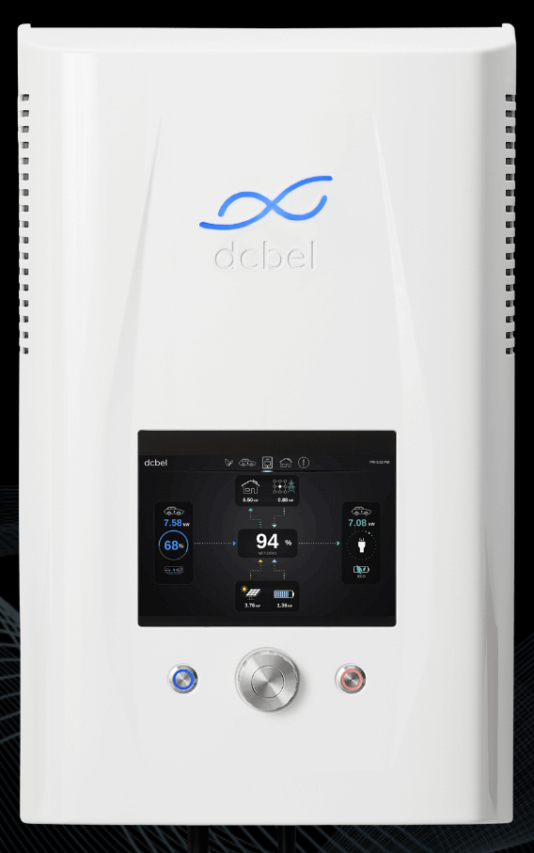
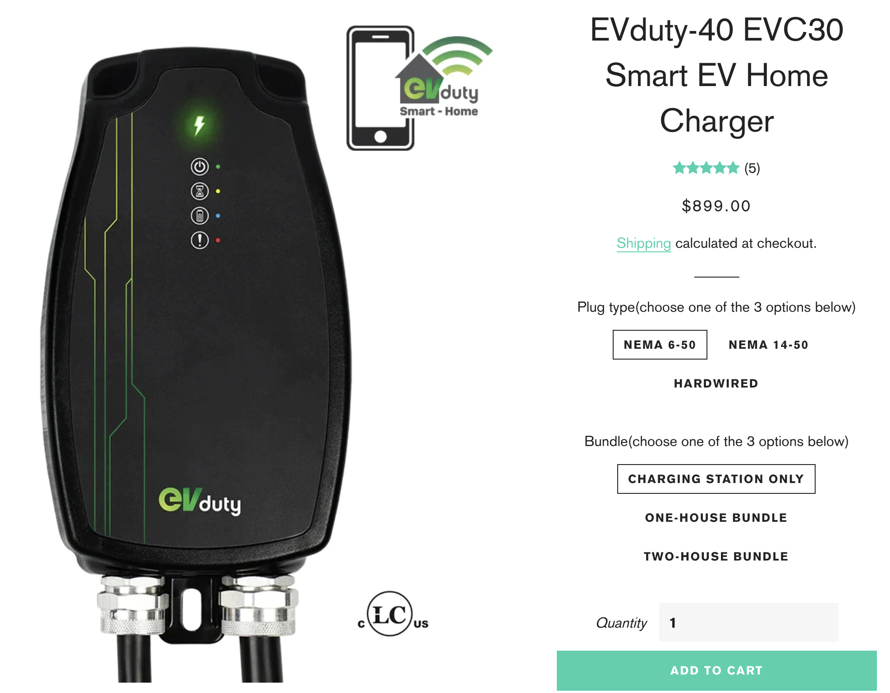


Load Flexible and Bidirectional EV Chargers

Slide 22
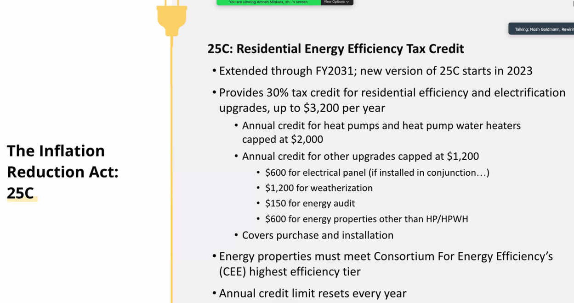

Slide 23
KRISTEN APPEARS ELIGIBLE FOR PSEG INTEREST-FREE ON-BILL REPAYMENT
Kristen is a PSEG customer of both electric and gas service. PSEG site https://homeenergy.pseg.com/heatingandcooling states you are eligible for INTEREST-FREE on-bill repayment to help defer the cost of your energy efficiency upgrades, including the purchase and installation of high-efficiency heating and cooling equipment. You may qualify for an on-bill repayment term of 84 months (seven years) for up to $25,000 of your total project cost.
If you meet the low- to moderate-income qualifications, you are eligible for a repayment term of 84 months (seven years) if your total amount borrowed is $10,000 or less. If you have project costs between $10,001 and $25,000, you can choose a term of either 84 months (seven years) or 120 months (10 years).
Your selected participating contractor will contact you to confirm your account eligibility and will provide information about PSE&G’s convenient on-bill repayment option, as well as additional incentives for Low- to Moderate-Income (LMI) customers.

Slide 24

Questions?

